Slide 1
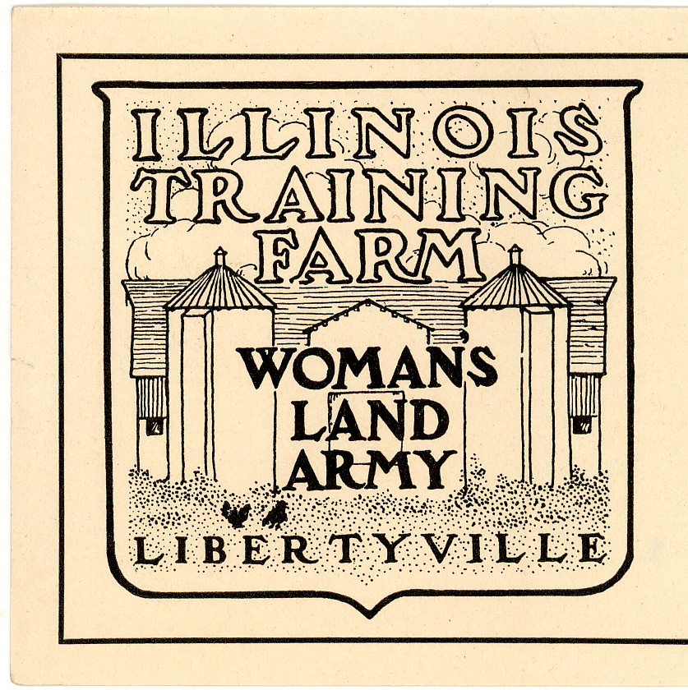
Sticker: “Illinois Training Farm: Woman’s Land Army, Libertyville”. From Illinois State Archives

Slide 2
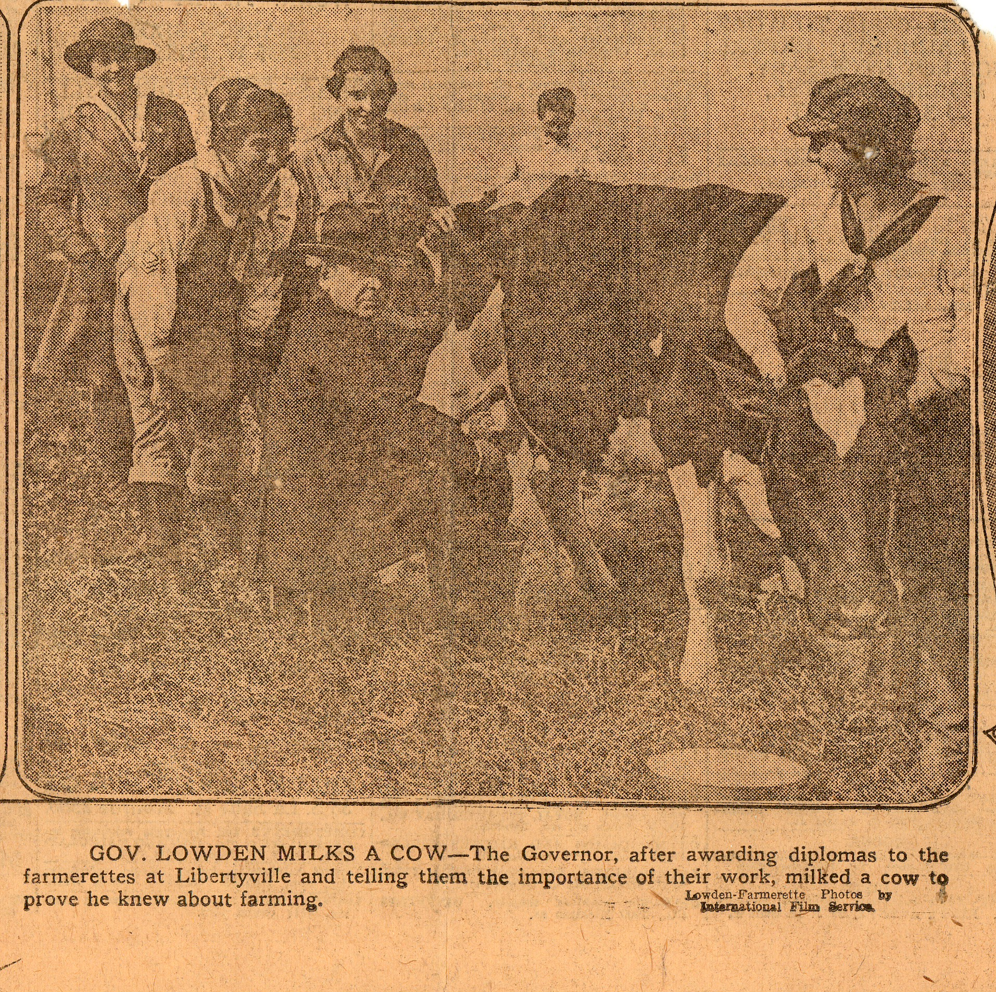
Newspaper clipping: Photographs – “Latest in Graduations Gowns-Khaki Overalls” and “Gov. Lowden Milks a Cow”. 1918 From Illinois State Archives
Notes:
What is going on in this photo?
Why is the Governor milking the cow?
What can you assume about the people in this photo?
What can you learn about the time period based on this photo?

Slide 3
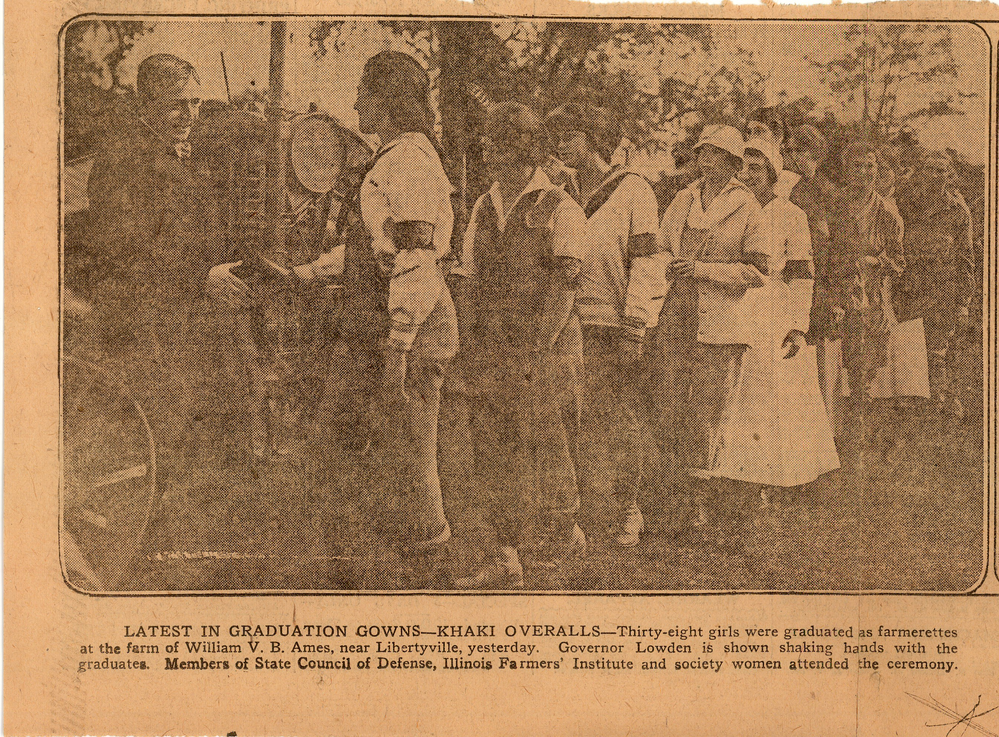
Newspaper clipping: Photographs – “Latest in Graduations Gowns-Khaki Overalls” and “Gov. Lowden Milks a Cow”. 1918 From Illinois State Archives
Notes:
What details/objects do you see in this photo?
What can you assume about the people in this photo?
What can you learn about the time period based on this photo?
What do you notice about the clothing?

Slide 4
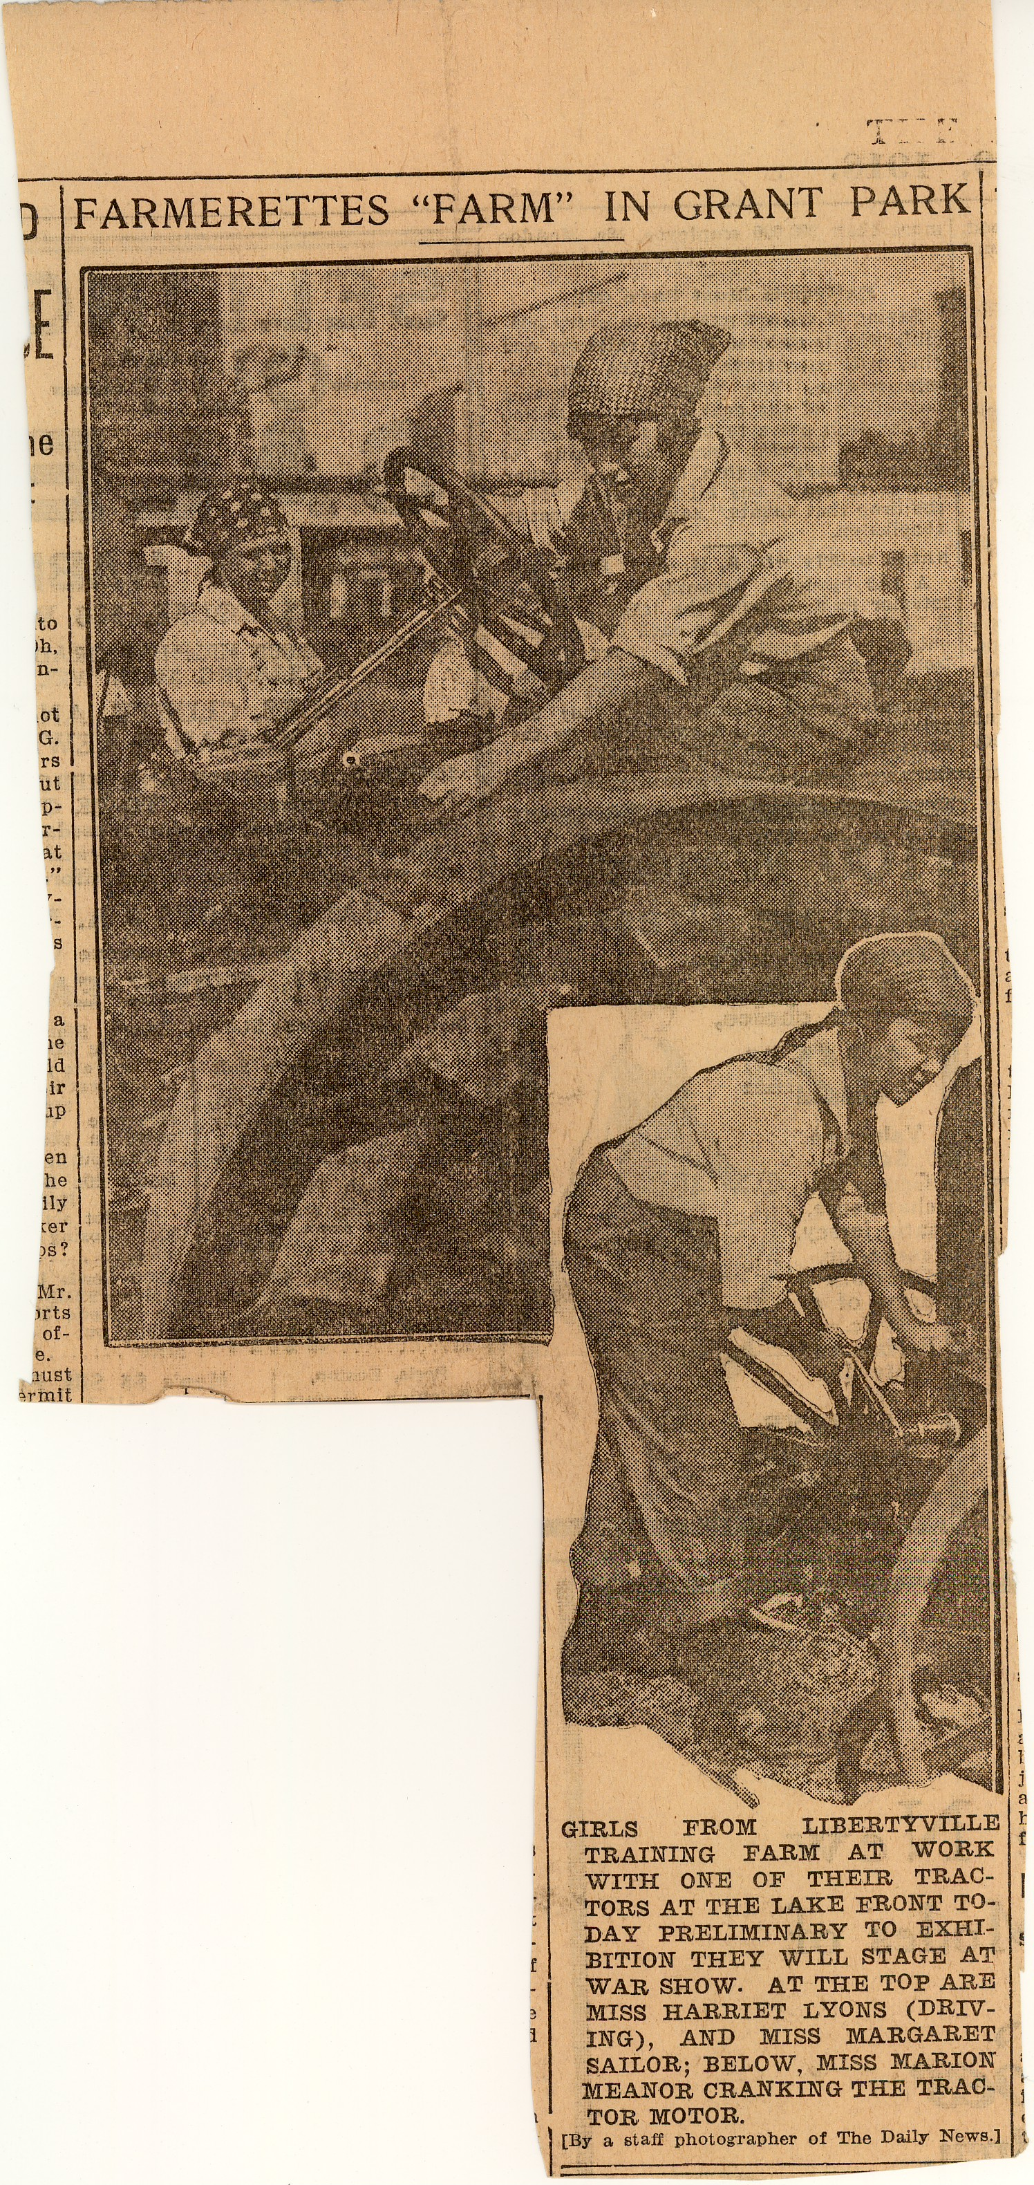
Newspaper clipping: Photographs – “Farmerettes ‘Farm’ in Grant Park”. 1918. From Illinois State Archives
Notes:
Where is the photo taken?
Why was it taken there?
How do you think these women were feeling at the time of this photo?
Using your previous knowledge about the time period, why are these photos unique?

Slide 5
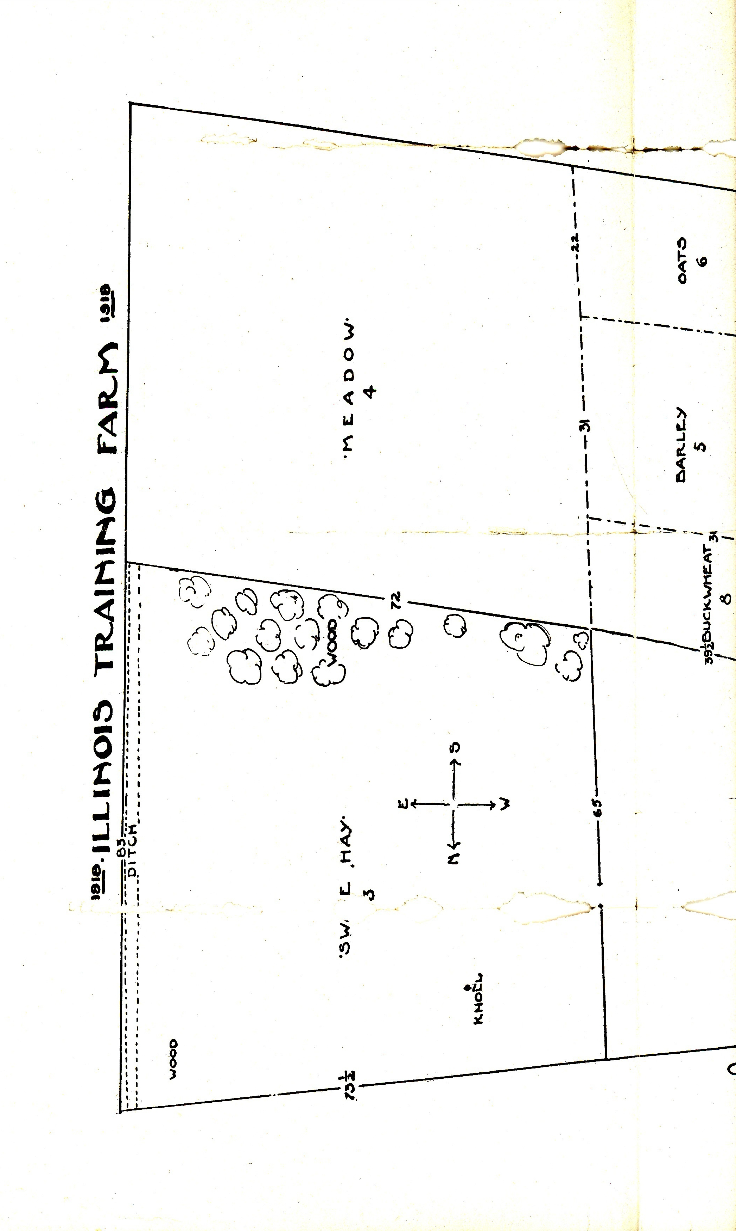
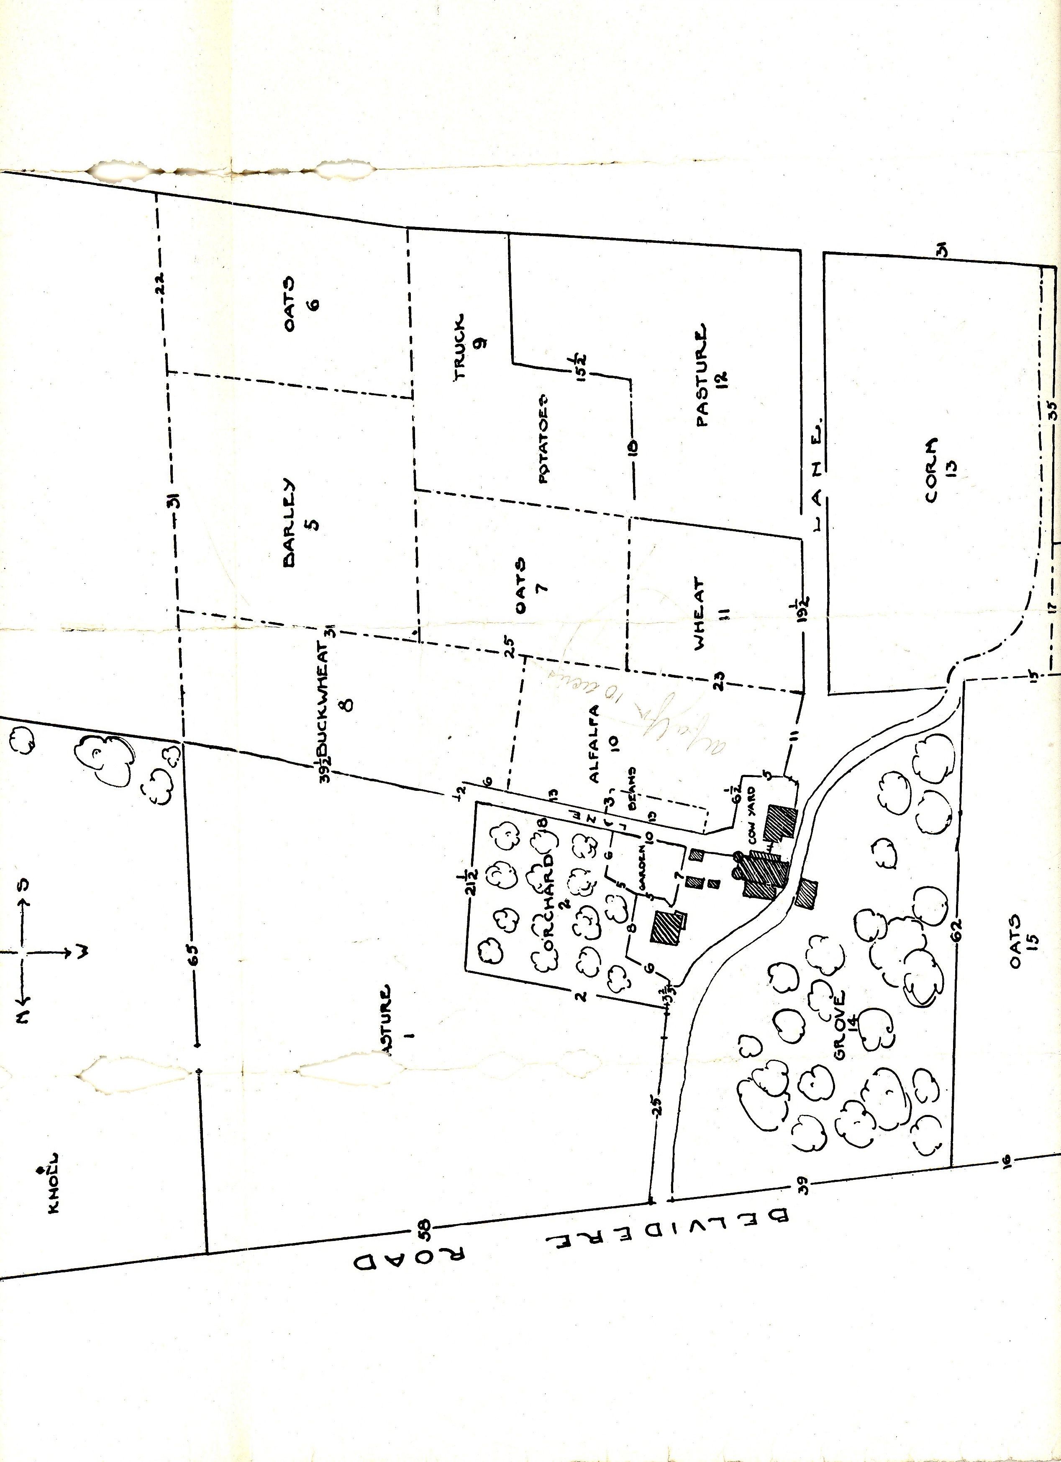
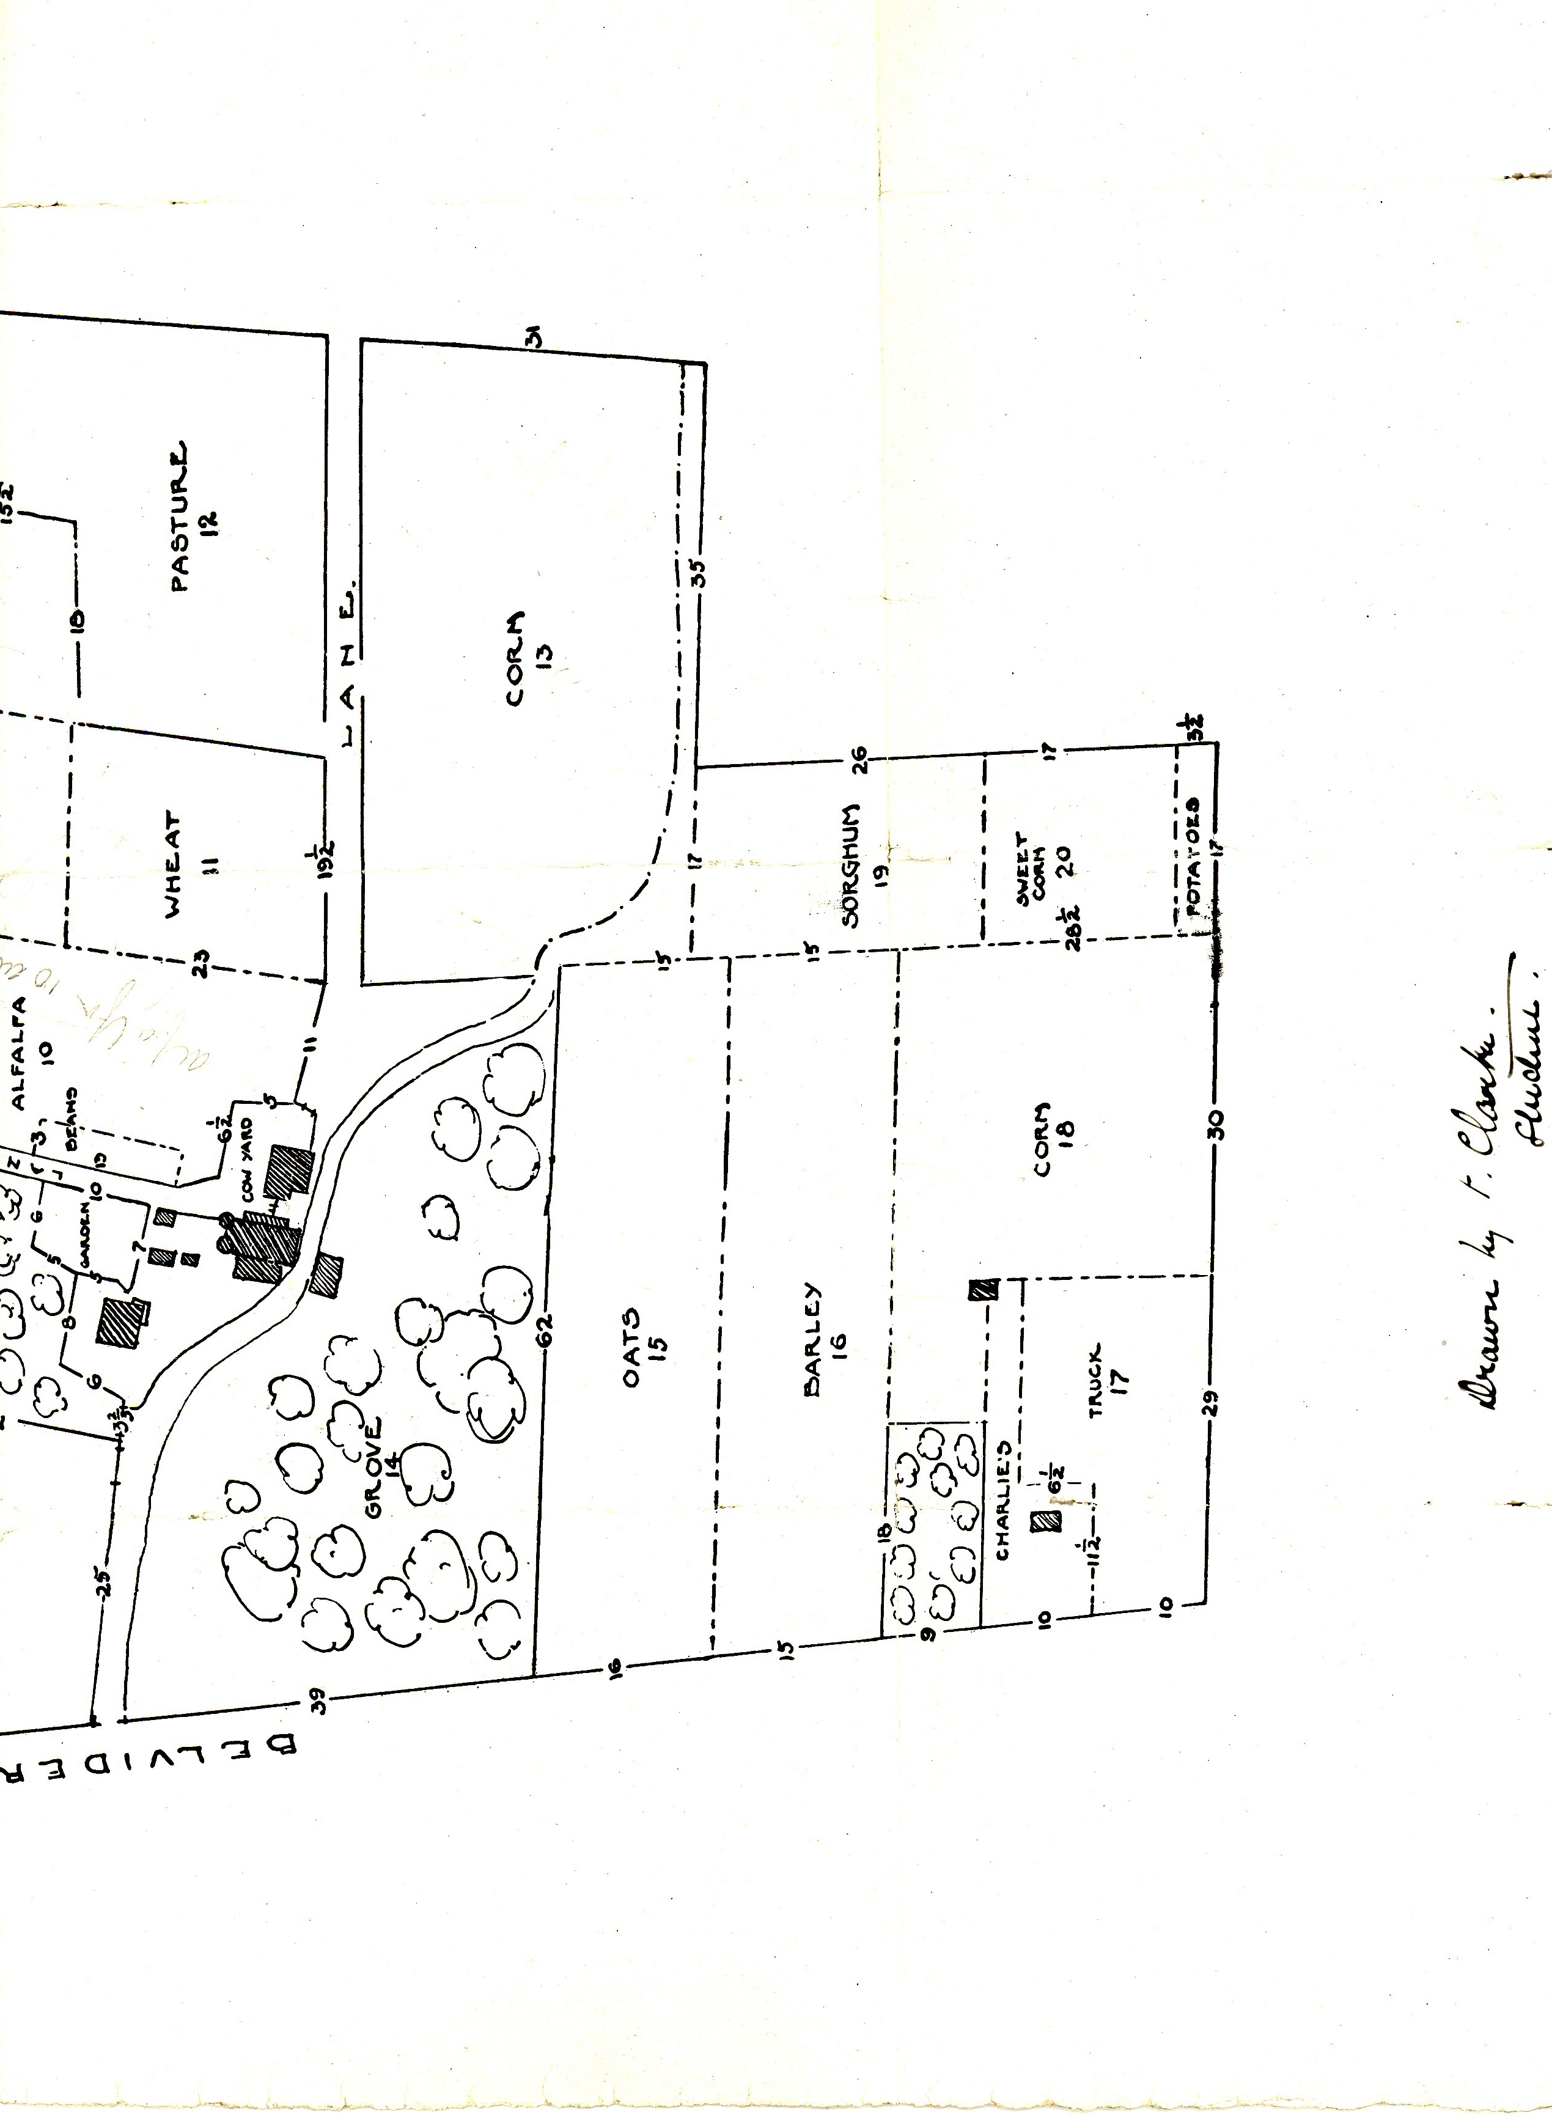
Property map: Illinois Training Farm, 1918. Illinois State Archives.
(Originally scanned in three parts and spliced together for this slide)
Notes:
Ask students to share all details they notice about the farm.

Slide 6
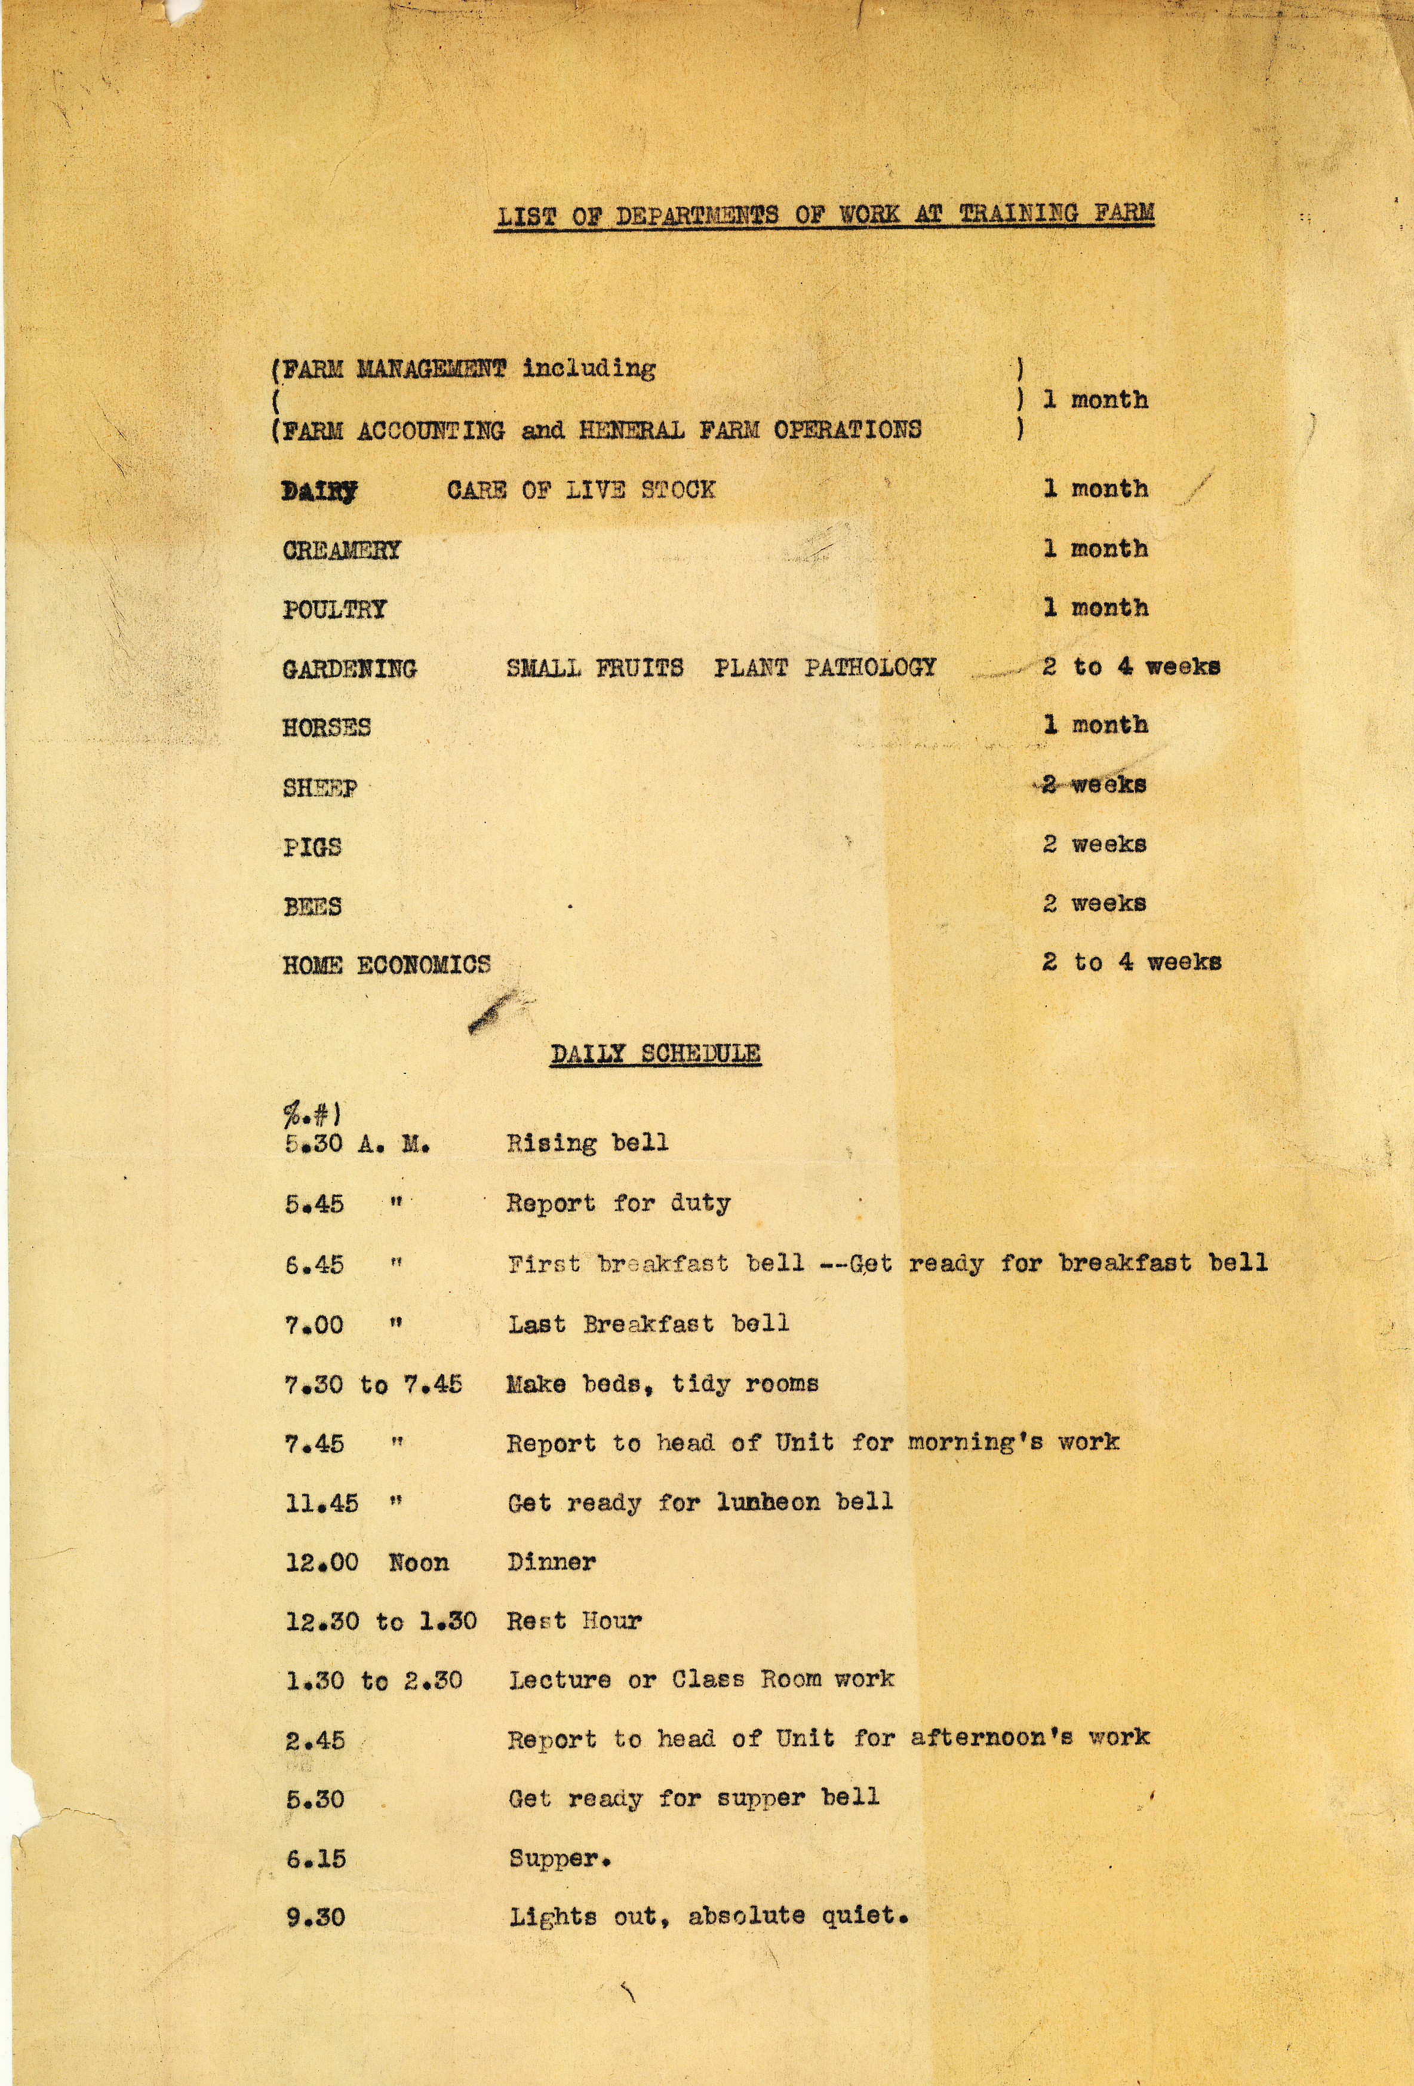
List of Departments of Work at Training Farm and Daily Schedule . From Illinois State Archives
Notes:
What details are on this paper?
What is different than what we might do/say today?
What can you infer about the farm from this paper?

